Slide 1
Friction
Friction: A force that resists the motion of an object across a surface.
Factors That Affect Friction:
The Normal Force applied by the surface on the object.
The types of materials in contact.
Note: Factors such as surface area and shape do not affect the force of friction.
F_{N}
F_{f}
F_{a}
F_{g}

Slide 2
Friction
Friction: A force that resists the motion of an object across a surface.
Factors That Affect Friction:
The Normal Force applied by the surface on the object.
The types of materials in contact.
Note: Factors such as surface area and shape do not affect the force of friction.
F_{N}
F_{f}
F_{a}
F_{g}

Slide 3
Coefficient of Friction
μ is the Coefficient of Friction
F_{f} = μF_{N}
The Coefficient of Friction is a physical property of the two materials in contact
Each combination of materials has a different value of μ
The value of μ is determined by experiment
F_{N}
F_{f}
F_{a}
F_{g}

Slide 4
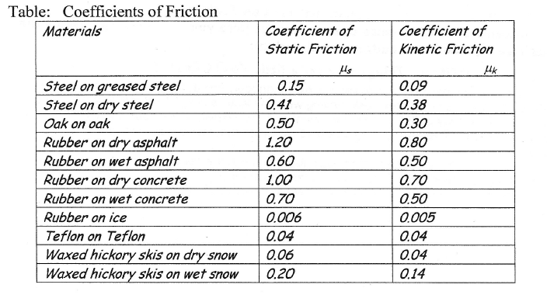
Coefficient of Friction

Slide 5
Kinetic Friction
Kinetic Friction: A force of friction that resists the motion of an object while the object is moving.
μ_{k} is the Coefficient of Kinetic Friction
F_{K} = μ_{K}F_{N}
If force of friction (F_{f}) equals F_{K} as long as the object is moving.
F_{K} does not depend on the applied force (F_{a})
F_{K} and F_{S} cannot be acting at the same time
μ_{k} and μ_{s} are usually different for the same combination of materials
F_{N}
F_{f}
F_{a}
F_{g}

Slide 6

Kinetic Friction – Sample Problem
Find the normal force (F_{N})
Determine if it is static or kinetic fiction
Look up the coefficient of friction (μ)
Use: F_{f} = μF_{N}

Slide 7
Kinetic Friction – Sample Problem
Find the normal force (F_{N})
F_{N} = mg F_{N} = (230)(9.81) = 2260 N
Determine if it is static or kinetic fiction
Kinetic (*** Note: Skidding tires are kinetic)
Look up the coefficient of friction (μ)
μ = 0.70 (Rubber on Dry Concrete)
Use: F_{f} = μF_{N}
F_{f} = (0.70)(2260) = 1580 N

Slide 8
Static Friction
Static Friction: A force of friction that prevents an object at rest from starting to move.
μ_{s} is the Coefficient of Static Friction
F_{S}(max) = μ_{s}F_{N}
If the applied force (F_{a}) is equal or less than F_{s}
Then F_{f} is equal but opposite to F_{a}
And the object does not move.
If the applied force (F_{a}) is greater than F_{s}
Then the object begins to move
Static Friction no longer applies
F_{N}
F_{f}
F_{a}
F_{g}

Slide 9

Static Friction – Sample Problem
Find the normal force (F_{N})
Determine if it is static or kinetic fiction
Calculate the coefficient of friction (μ)
μ = ? (Asked to calculate Wood on Dry snow)
Use: F_{f} = μF_{N}

Slide 10
Static Friction – Sample Problem
Find the normal force (F_{N})
F_{N} = mg F_{N} = 5450 N
Determine if it is static or kinetic fiction
Static (**** Note: “just starting to move”)
Calculate the coefficient of friction (μ)
μ = ? (Asked to calculate Wood on Dry snow)
Use: F_{f} = μF_{N}
μ = F_{f} / F_{N} μ = 88 / 5450 = 0.016

Slide 11
Some Final Thoughts
Note that μ_{k} is usually less than μ_{s}
Can μ_{k} be exactly equal to μ_{s}?
Describe the motion as you start pulling on an object initially at rest.
Can μ_{k} be greater than μ_{s}?
Describe the motion as you start pulling on an object initially at rest.

